Slide 1

Storage-Device Hierarchy

Slide 2
Going Down the Hierarchy
Decreasing cost per bit
Increasing capacity
Increasing access time

Slide 3
Introduction to Caches
Cache
  is a small very fast memory (SRAM, expensive)
  contains copies of the most recently accessed memory locations (data and instructions): temporal locality
  is fully managed by hardware (unlike virtual memory)
  storage is organized in blocks of contiguous memory locations: spatial locality
  unit of transfer to/from main memory (or L2) is the cache block

Slide 4
Cache Fundamentals
The cache(s) is where the CPU may find data items that are closer to it than the main memory
A cache hit is when a data item is found in a (level of) cache
A cache miss is when a data item is not found
The cache consists of block frames
  Each block frame can contain a block

Slide 5
Cache Memory
motivated by the mismatch between processor and memory speed
closer to the processor than the main memory
smaller and faster than the main memory
transfer between caches and main memory is performed in units called cache blocks/lines
caches contain also the value of memory locations which are close to locations which were recently accessed (spatial locality)
Physical vs. virtual addressing
Cache performance: miss ratio, miss penalty, average access time
invisible to the OS

Slide 6
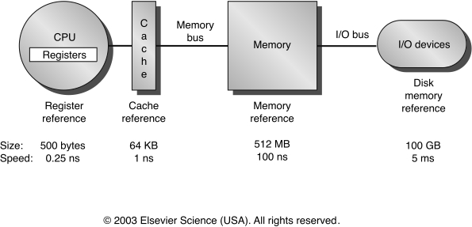
The Memory Hiearchy
fast
slow
small
large

Slide 7
Cache Fundamentals
Cache uses SRAM: Static Random Access Memory
  No refresh (6 transistors/bit vs. 1 transistor
  Main Memory is DRAM: Dynamic Random Access Memory
  Dynamic since needs to be refreshed periodically

Slide 8
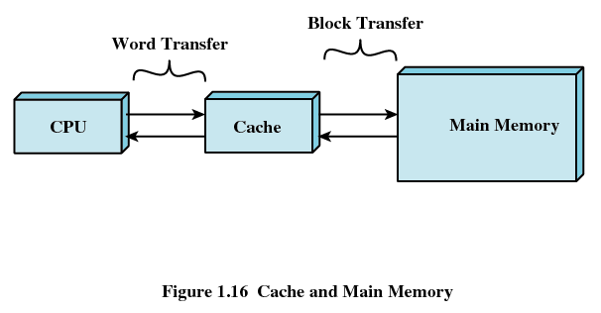
Cache-Memory Transfers

Slide 9
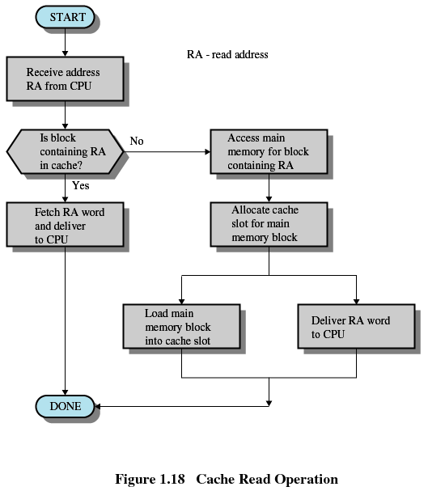
Cache Read Operation

Slide 10
Types of Memory
Real memory
  Main memory
Virtual memory
  Memory on disk
  Allows for effective multiprogramming and relieves the user of tight constraints of main memory

Slide 11
Virtual Memory
Virtual memory – separation of user logical memory from physical memory.
  Only part of the program needs to be in memory for execution
  Logical address space can therefore be much larger than physical address space
  Allows for more efficient process creation
Virtual memory can be implemented via:
  Demand paging
  Demand segmentation

Slide 12
Virtual Memory Diagram
Fig. 9.1, p.291
virtual memory
page 0
page 1
page 2
page 3
secondary
storage
memory
map
physical
memory
page n

Slide 13
What is VM?
Program:
  ....
  Mov AX, 0xA0F4
  ....
Table
(one per
Process)
0xA0F4
Mapping
Unit
(MMU)
0xC0F4
Virtual
Address
„Piece“ of Virtual Memory
Physical Memory
„Piece“ of Physical Memory
Physical
Address
Virtual Memory
Notes:
Not only address to address mapping, but piece to piece
VAS usually much larger than PAS

Slide 14
1.1 Why Virtual Memory (VM)?
Shortage of memory
  Efficient memory management needed
  Process may be too big for physical memory
  More active processes than physical memory can hold
Requirements of multiprogramming
  Efficient protection scheme
  Simple way of sharing
Process 3
Process 2
Process 4
Process 1
OS
Memory
Notes:
Mention external fragmentation

Slide 15
1.3 The Mapping Process
Usually every process has its own mapping table
Not every „piece“ of VM has to be present in PM
  „Pieces“ may be loaded from HDD as they are referenced
  Rarely used „pieces“ may be discarded or written out to disk (→ swapping)
check using mapping table
piece
in physical
memory?
OS brings
„piece“ in
from HDD
virtual
address
memory
access fault
yes
OS adjusts
mapping
table
physical
address
translate
address
MMU

Slide 16
Demand Paging
Bring a page into memory only when it is needed
  Less I/O needed
  Less memory needed
  Faster response
  More users
Page is needed ⇒ reference to it
  invalid reference ⇒ abort
  not-in-memory ⇒ bring to memory

Slide 17
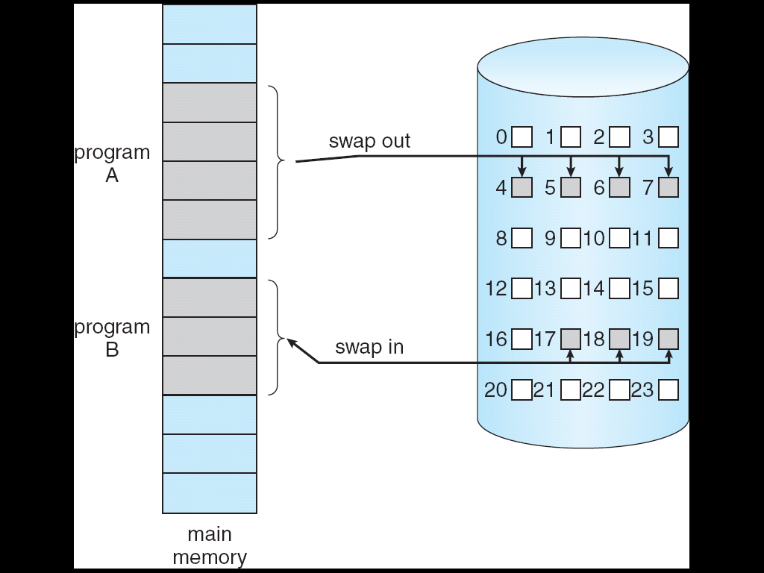
Transfer of a Paged Memory to Contiguous Disk Space

Slide 18
To replace pages or segments of data in memory. Swapping is a useful technique that enables a computer to execute programs and manipulate data files larger than main memory. When the operating system needs data from the disk, it exchanges a portion of data (called a page or segment ) in main memory with a portion of data on the disk.
DOS does not perform swapping, but most other operating systems, including OS/2, Windows, and UNIX, do.
Swapping is often called paging.
When set of paged data sets moved from auxiliary storage to
real storage during execution of any job is called swap-in.
Reverse is swap out.

Slide 19
What is a process
We typically mean that a process is a running program
A better definition is that a process is the state of a running program
Now we have a really good definition of the state of a running program
  A program counter
  A page table
  Register values

Slide 20
Address Translation
Physical Memory
CPU
A.1
@8190
B.1
C.1
A.2
virtual
addresses
0-4095
4096-8191
8192-12287
12288-16384
C.4
address
translation
C.6
Process A
B.2
A.1
B.3
A.2
A.3
A.4
A.3
A.4
C.2
Disk
C.3
C.5
. . .
. . .

Slide 21
Example
Process A
Physical Memory
A.1
A.2
A.3
A.4
Process B
B.1
B.2
B.3
Process C
C.1
C.2
C.3
Disk
C.4
C.5
C.6

Slide 22
Example: Memory Snapshot
Process A
Physical Memory
A.1
A.2
A.1
A.3
B.1
A.4
C.1
A.3
Process B
C.4
C.6
B.1
B.2
B.2
B.3
B.3
Process C
C.1
A.2
C.2
A.4
C.3
C.2
Disk
C.4
C.3
C.5
C.5
C.6
. . .
. . .

Slide 23
Memory Protection
Process A
Physical Memory
A.1
A.2
A.1
A.3
B.1
A.4
C.1
A.3
Process B
C.4
B.1
C.6
B.2
B.2
B.3
B.3
Process C
C.1
A.2
C.2
A.4
C.3
C.2
Disk
C.4
C.3
C.5
C.5
C.6
. . .
. . .
Virtual memory ensures protection
Process A cannot cannot read/write into the memory of process B
As we’re going to see, this is easily enforced by the virtual memory address translation scheme

Slide 24
Paging
Each process has its own page table
Each page table entry contains the frame number of the corresponding page in main memory
A bit is needed to indicate whether the page is in main memory or not

Slide 25
Page Tables
The entire page table may take up too much main memory
Page tables are also stored in virtual memory
When a process is running, part of its page table is in main memory

Slide 26
Page Size
Smaller page size, less amount of internal fragmentation
Smaller page size, more pages required per process
More pages per process means larger page tables
Larger page tables means large portion of page tables in virtual memory

Slide 27
Page Faults
A miss in the page table is called a page fault
When the “valid” bit is not set to 1, then the page must be brought in from disk, possibly replacing another page in memory

Slide 28
VM:Sharing
„Pieces“ of different processes mapped to one single „piece“ of physical memory
Piece 0
Piece 0
Piece 0
Piece 1
Piece 1
Piece 1
Piece 2
Piece 2
Piece 2
Physical
memory
shared
memory
Virtual memory
Process 1
Virtual memory
Process 2
Notes:
Shared Code must be reentrant (non-self-modifying)

Slide 29
VM: Advantages
VM supports
  Swapping
    Rarely used „pieces“ can be discarded or swapped out
    „Piece“ can be swapped back in to any free piece of physical memory large enough, mapping unit translates addresses
  Protection
  Sharing
    Common data or code may be shared to save memory
Code can be placed anywhere in physical memory without relocation (adresses are mapped!)

Slide 30
VM: Disadvantages
Memory requirements (mapping tables)
Longer memory access times (mapping table lookup)

Slide 31
Pipelining
The key technique today to achieve high performance in computer architecture
Pipelining is an implementation technique that allows the execution of multiple instructions to be overlapped
  Comes from the realization that executing an instruction can be performed in multiple stages, and that two instructions can be in different stages at the same time

Slide 32
What is a pipeline?
It is an “assembly line” that consists of multiple steps
Each step contributes to the execution of an instruction
  The book makes an analogy to an assembly line for building cars
Each step is called a pipe stage
Each stages is connected on to the next to form a pipe
  Instructions enter at one end and come out at the other end
Example:
  Supposed there are 4 things to do to perform an instruction in the processor
  These 4 things are independent (i.e., they don’t use the same hardware, they don’t require the same tools)
stage 1
stage 2
stage 3
stage 4
time

Slide 33
Pipeline throughput
The throughput of a pipeline is defined as the number of instructions that can be executed per time unit
All stages proceed in synchronized fashion
  they all start at the same times (simplifies hardware design)
The time required for moving one instruction down the pipeline is called a processor cycle (not to be confused with clock cycle)
Because all pipe stages must be ready to proceed synchronously, the processor cycle is determined by the slowest stage
1
throughput = ----------------------------------------
  duration of the slowest stage
duration of the
slowest stage

Slide 34
Pipelining
With the previous 5 stages, pipelining is very straightforward
  Just start a new instruction at each cycle
  The speedup due to pipelining is therefore a factor 5 because we have 5 stages
clock cycle
Instruction 1 2 3 4 5 6 7 8
i IF ID EX MEM WB
i+1 IF ID EX MEM WB
i+2 IF ID EX MEM WB
i+3 IF ID EX MEM WB

Slide 35
Pipelining Example
Consider the following code
    I1: LD R2, 12(R3)
    I2: DADD R4, R5, R6
Pipelined execution is in 6 steps total
1 2 3 4 5 6
LD R2, 12(R3):
IF
ID
EX
MEM
WB
DADD R3, R5, R6:
IF
ID
EX
MEM
WB

Slide 36
Pipelining Example
LD R2, 12(R3):
IF
ID
EX
MEM
WB
DADD R3, R5, R6:
IF
ID
EX
MEM
WB
First step: I1 in IF, I2 not issued yet

Slide 37
Pipelining Example
LD R2, 12(R3):
IF
ID
EX
MEM
WB
DADD R3, R5, R6:
IF
ID
EX
MEM
WB
Second step: I1 in ID, I2 in IF

Slide 38
Pipelining Example
LD R2, 12(R3):
IF
ID
EX
MEM
WB
DADD R3, R5, R6:
IF
ID
EX
MEM
WB
Third step: I1 in EX, I2 in ID

Slide 39
Pipelining Example
LD R2, 12(R3):
IF
ID
EX
MEM
WB
DADD R3, R5, R6:
IF
ID
EX
MEM
WB
Fourth step: I1 in MEM, I2 in EX

Slide 40
Pipelining Example
LD R2, 12(R3):
IF
ID
EX
MEM
WB
DADD R3, R5, R6:
IF
ID
EX
MEM
WB
Fifth step: I1 in WB, I2 in MEM

Slide 41
Pipelining Example
LD R2, 12(R3):
IF
ID
EX
MEM
WB
DADD R3, R5, R6:
IF
ID
EX
MEM
WB
Six step: I1 done, I2 in WB

Slide 42
Pipelining and Hardware
We’re now ready to look more closely at hardware resources used in a pipeline execution
It’s easier to see this on a picture, with the following symbols
  Memory: IF, MEM
  Register File: ID, WB
  ALU: EX
Mem
Reg
ALU

Slide 43
Pipelining and Hardware
5 stages
Mem
Reg
Mem
Reg
ALU
Mem
Reg
Mem
Reg
ALU
instructions
Mem
Reg
Mem
Reg
ALU
Mem
Reg
Mem
. . .
ALU

Slide 44
Pipelining and Hardware
Conflict
Mem
Reg
Mem
Reg
ALU
Mem
Reg
Mem
Reg
ALU
instructions
Mem
Reg
Mem
Reg
ALU
Mem
Reg
Mem
. . .
ALU

Slide 45
Instruction and Data Memory
One way to remove the conflict is to treat memory accesses differently
  Memory accesses for instructions
  Memory accesses for data
Can be done by having
  Instruction Memory (IM)
  Data Memory (DM)

Slide 46
Pipelining and Hardware
IM
Reg
DM
Reg
ALU
IM
Reg
DM
Reg
ALU
instructions
IM
Reg
DM
Reg
ALU
IM
Reg
DM
. . .
ALU

Slide 47
Pipelining and Hardware
Conflict
IM
Reg
DM
Reg
ALU
IM
Reg
DM
Reg
ALU
instructions
IM
Reg
DM
Reg
ALU
IM
Reg
DM
. . .
ALU

